Slide 1

NBA Win Prediction:
Sports Capstone
Grant Robinson

Slide 2
Outline
Problem Statement
Dataset Overview
EDA
Preprocessing/Feature Engineering
Methodology - Experiment Setup
Hyperparameter Tuning
Methodology - Evaluation Criteria
Model comparison
Statistical Analysis
Error Analysis/Interpretation
Results
Potential for Future Work

Slide 3
Problem Statement
Predicting NBA game outcomes is challenging because team performance fluctuates throughout the season. Teams are often evaluated based on their season record or reputation instead of their recent performance trends.
Research Questions:
Can recent team performance trends accurately predict the outcome of an NBA game?
Which Performance Metrics are most associated with winning NBA Games?
Hypothesis:
Random Forest and XGBoost, trained on the same leakage-safe rolling team statistics, will predict game outcomes more accurately than Logistic Regression

Slide 4
Dataset Overview
Source: Kaggle, NBA traditional box scores dataset (1997–2025)
Compiled from official NBA game logs
Filtered to the 2025 regular season only
1,230 games (2,460 team-game rows, one row per team per game)
29 raw features per row (points, shooting %, rebounds, assists, turnovers, steals, blocks, etc.)
Target: win/loss

Slide 5
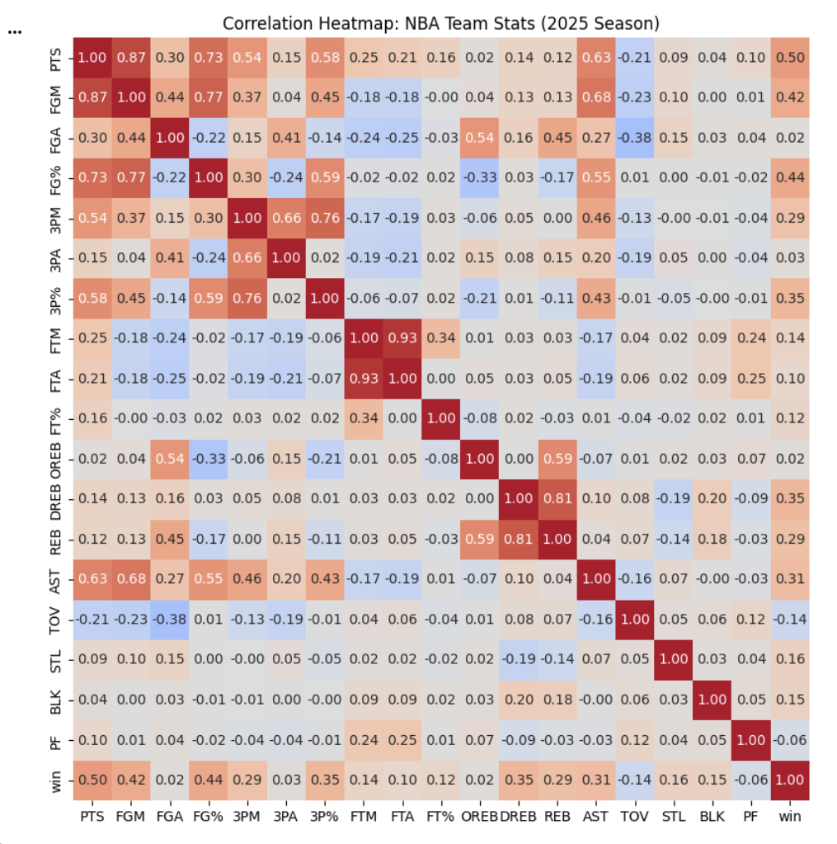
EDA
heatmap shows how each raw box score statistic relates to every other statistic and to the target variable win

Slide 6
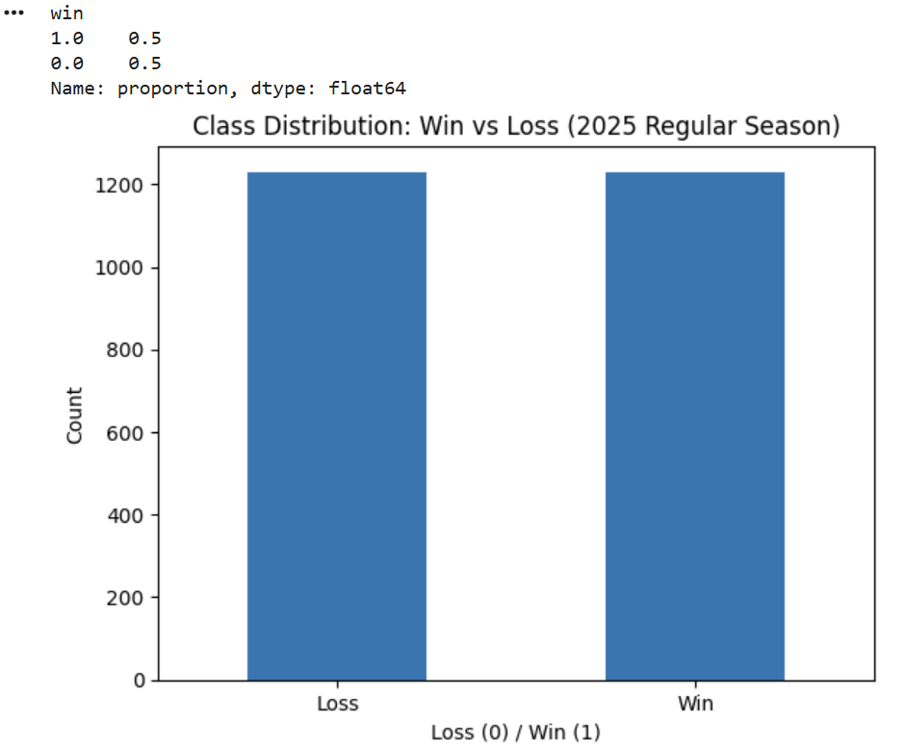
EDA
bar chart shows the distribution of the target variable, win, which is exactly balanced at 50% each, since every game produces one winning and one losing team.
confirms no resampling or class weighting was needed

Slide 7
Preprocessing/Feature Engineering
Created leakage-safe rolling averages using information only previous games (shift(1))
Engineered rolling averages for 8 key performance statistics (Pts, FG%, 3P%, REB, AST, TOV, STL, BLK)
Added contextual features:
is_home → captures home court advantage
rest_days → captures scheduling/fatigue effects

Slide 8
Preprocessing/Feature Engineering
Evaluated multiple rolling window sizes (5 games, 10 games, 15 games, 20 games, 25 games)
Treated rolling window length as a parameter to test rather than assuming one timeframe
Trained Logistic Regression models using each window while keeping the modeling setup consistent
Selected the 20-game rolling window based on highest performance:
Accuracy: 0.621
ROC-AUC: 0.664
Performance declined with the 25-game window, showing that longer history did not always improve predictions

Slide 9
Preprocessing/Feature Engineering
Verified data quality: no missing values detected
Confirmed balanced target variable:
Train: 50.1% wins / 49.9% losses
Test: 50.4% wins / 49.6% losses
No resampling or class weighting required
Used a chronological 80/20 train-test split to preserve the time-series structure and prevent data leakage
Standardized numerical features using StandardScaler (fit only on training data)

Slide 10
Methodology – Experiment Setup
Dataset
2025 NBA Regular Season team-game data
1,230 games → 2,400 usable observations after rolling feature creation
Features
10 final features:
8 leakage-safe 20-game rolling statistics
is_home + rest_days
Validation
Chronological 80/20 train-test split
5-fold TimeSeriesSplit cross-validation
No shuffling to prevent future data leakage
Models & Tuning
Persistence baseline, Logistic Regression (baseline), Random Forest, XGBoost
GridSearchCV optimization

Slide 11
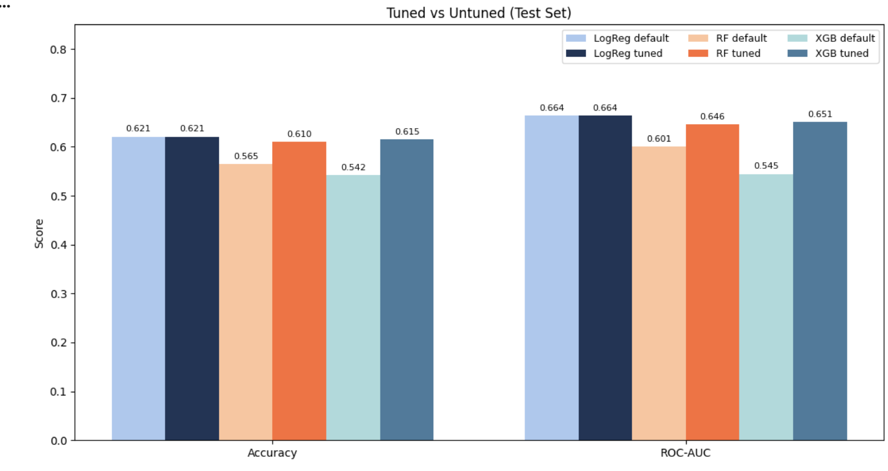
Hyperparameter Tuning
Logistic Regression results:
C = 0.5
penalty = 'l2'
class_weight = 'balanced'
Random Forest results:
n_estimators = 100
max_depth = 5
min_samples_leaf = 5
XGBoost results:
n_estimators = 100
max_depth = 3
learning_rate = 0.01

Slide 12
Methodology – Evaluation Criteria
Primary metric: ROC-AUC
Measures how well the model distinguishes between wins and losses across all probability thresholds
Threshold-independent, making it well suited for comparing Logistic Regression, Random Forest, and XGBoost
Because the dataset is balanced, no single prediction error was weighted more heavily than another
Also reported: Accuracy, Precision, Recall, F1-score, and the Confusion Matrix

Slide 13
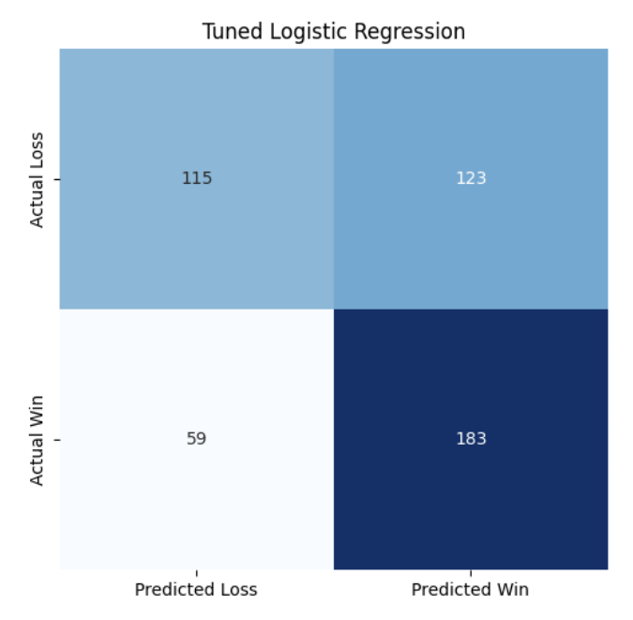
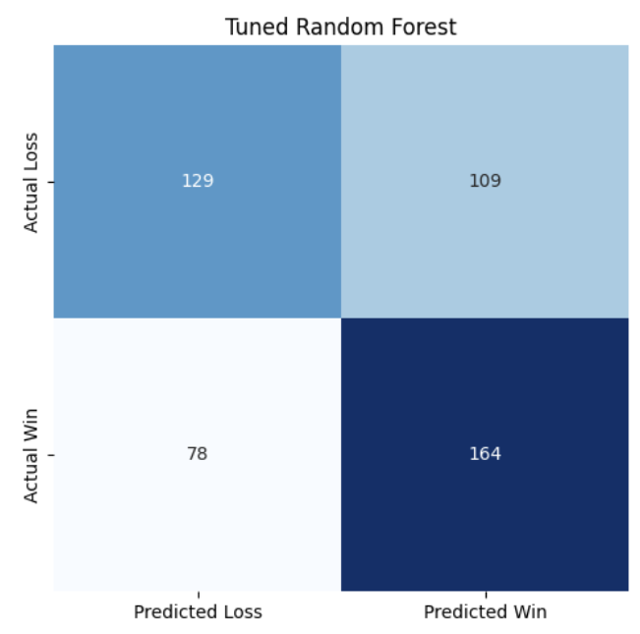
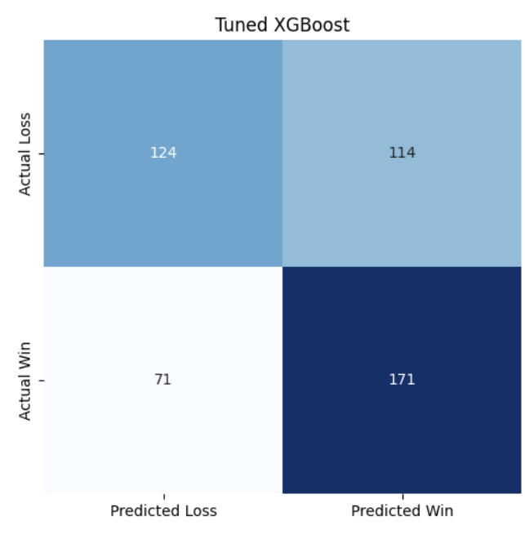
Model Comparison
Confusion Matrices for each Model

Slide 14
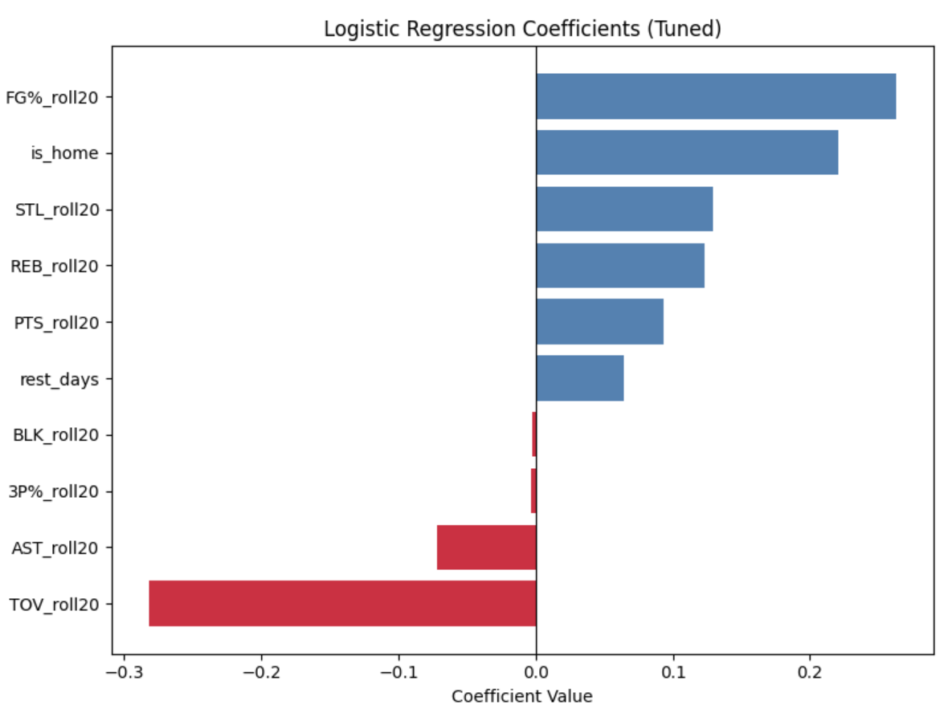
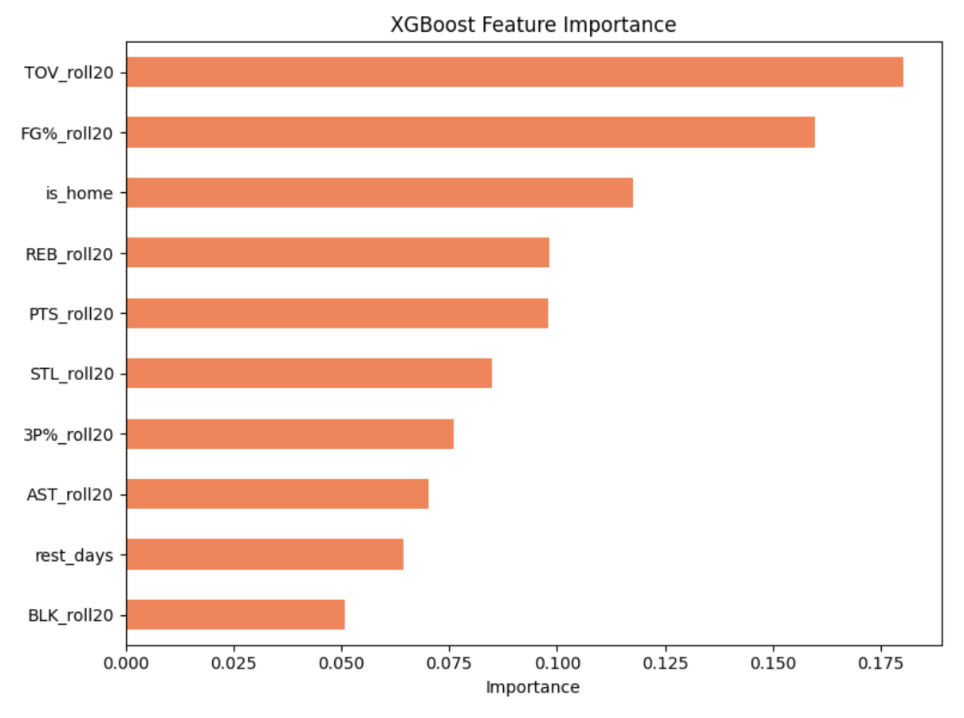
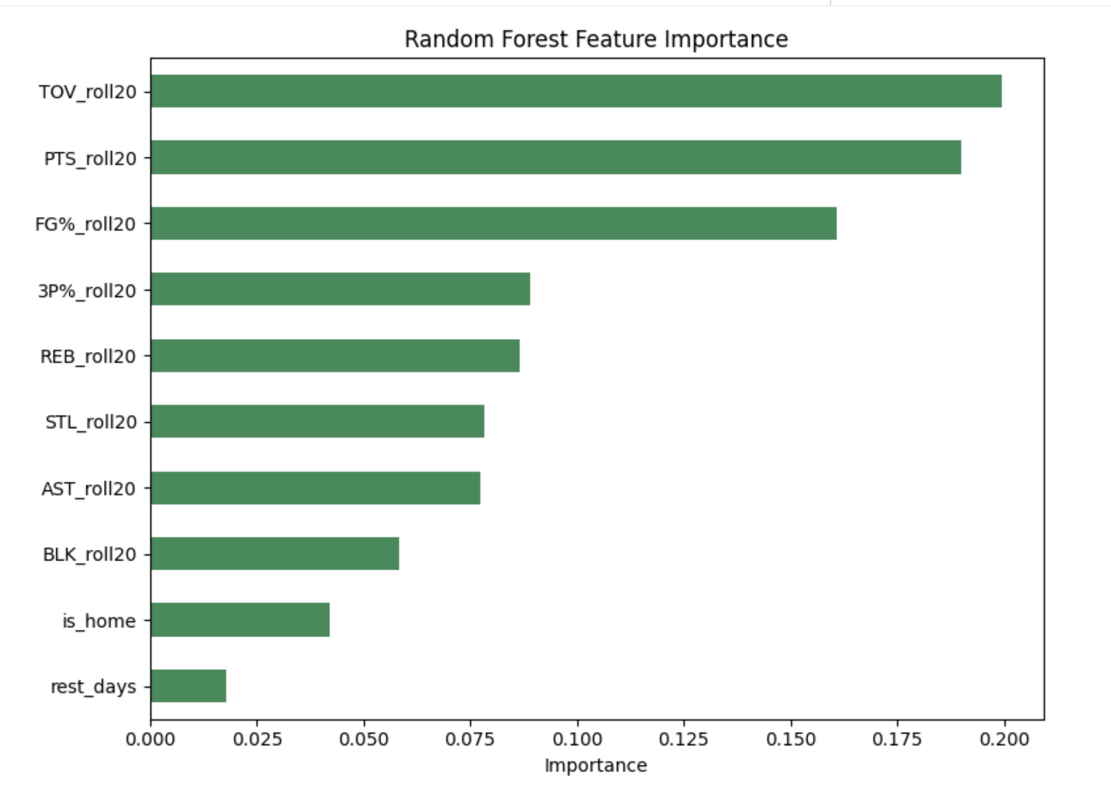
Model Comparison

Slide 15
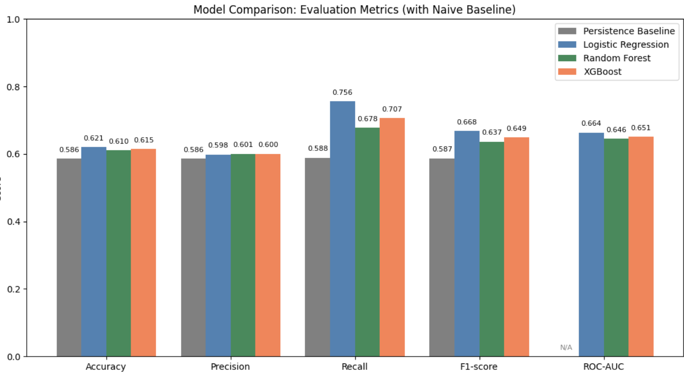
Model Comparison

Slide 16
Statistical Analysis
Bootstrap Confidence Intervals (Primary Test)
Compared ROC-AUC across 5 cross-validation folds
Logistic Regression significantly outperformed Random Forest and XGBoost (95% CI excluded 0)
Wilcoxon Signed-Rank Test
Used due to the small number of cross-validation folds (n = 5)
No statistically significant differences detected
McNemar's Test
Compared test-set prediction errors between models
No statistically significant differences detected

Slide 17
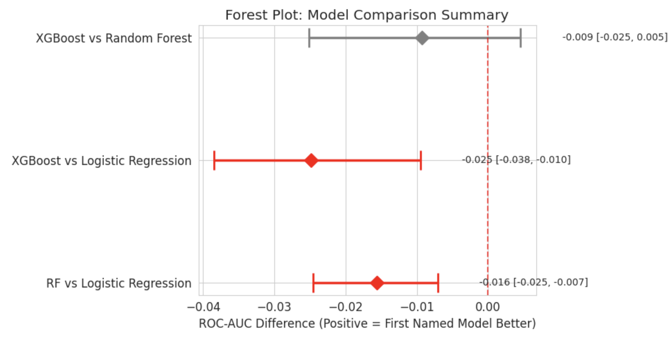
Statistical Analysis

Slide 18
Error Analysis/Interpretation
Models struggled to exceed ~0.62 accuracy / ~0.66 ROC-AUC, regardless of complexity
Dataset
-No opponent-strength data
Hypothesis refuted
-Logistic Regression outperformed Random Forest and XGBoost based on bootstrap confidence intervals

Slide 19
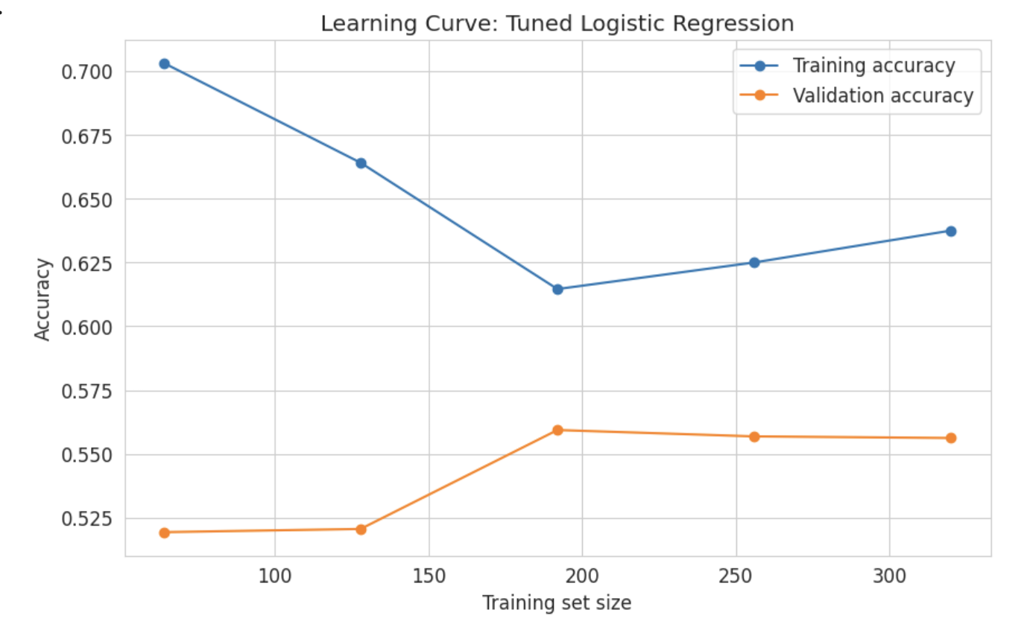
Error Analysis/ Interpretation

Slide 20
Results
Strengths
Window size (5, 10, 15, 20, 25 games) tested rather than assumed
Compared models against a persistence baseline appropriate for time-series prediction
Used hyperparameter tuning and multiple statistical tests to validate results
Limitations
Feature set
No opponent strength data, model only sees a team's own recent form
Mild multicollinearity because of basketball features
Sample size / scope
Single season (2025) only

Slide 21
Results
Biases
Data limitations
Box scores are reliable but only capture recorded game statistics. Doesn't capture trades, injuries, or roster changes.
Performance was not tested across specific teams, conferences, or different quality of teams.
Societal Impact:
Modest predictive power risks false confidence in betting contexts
Could support analytics, broadcasting, or help identify performance trends.

Slide 22
Potential for Future Work
Extend to multiple seasons for a larger, more generalizable sample
Add opponent-strength features (recent opponent win %, rolling opponent stats), rerun methodology
Test window size separately for Random Forest and XGBoost, rather than assuming the Logistic Regression-optimal window transfers

Slide 23
Thank you!
Questions?

